Slide 1
Detecting Pneumonia Using Image Processing
Nichole Hartz
Capstone 3

Slide 2
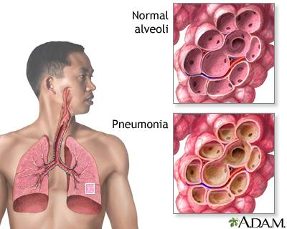
Pneumonia
Lung infection that inflames air sacs
Air sacs fill with liquid or pus
Range from mild to severe
Bacterial, viral or fungal
Notes:
Pneumonia is a type of infection that inflame the air sacs in one or both lungs.
The air sacs can fill with liquid or pus.
Infections range from mild to severe.
And are caused by bacteria, viruses, or fungi
Anyone can develop this infection but individuals with weaker immune systems are more susceptible.
Symptoms vary but some common symptoms are: chest pain, cough, fatigue, fever, nausea and shortness of breath.

Slide 3
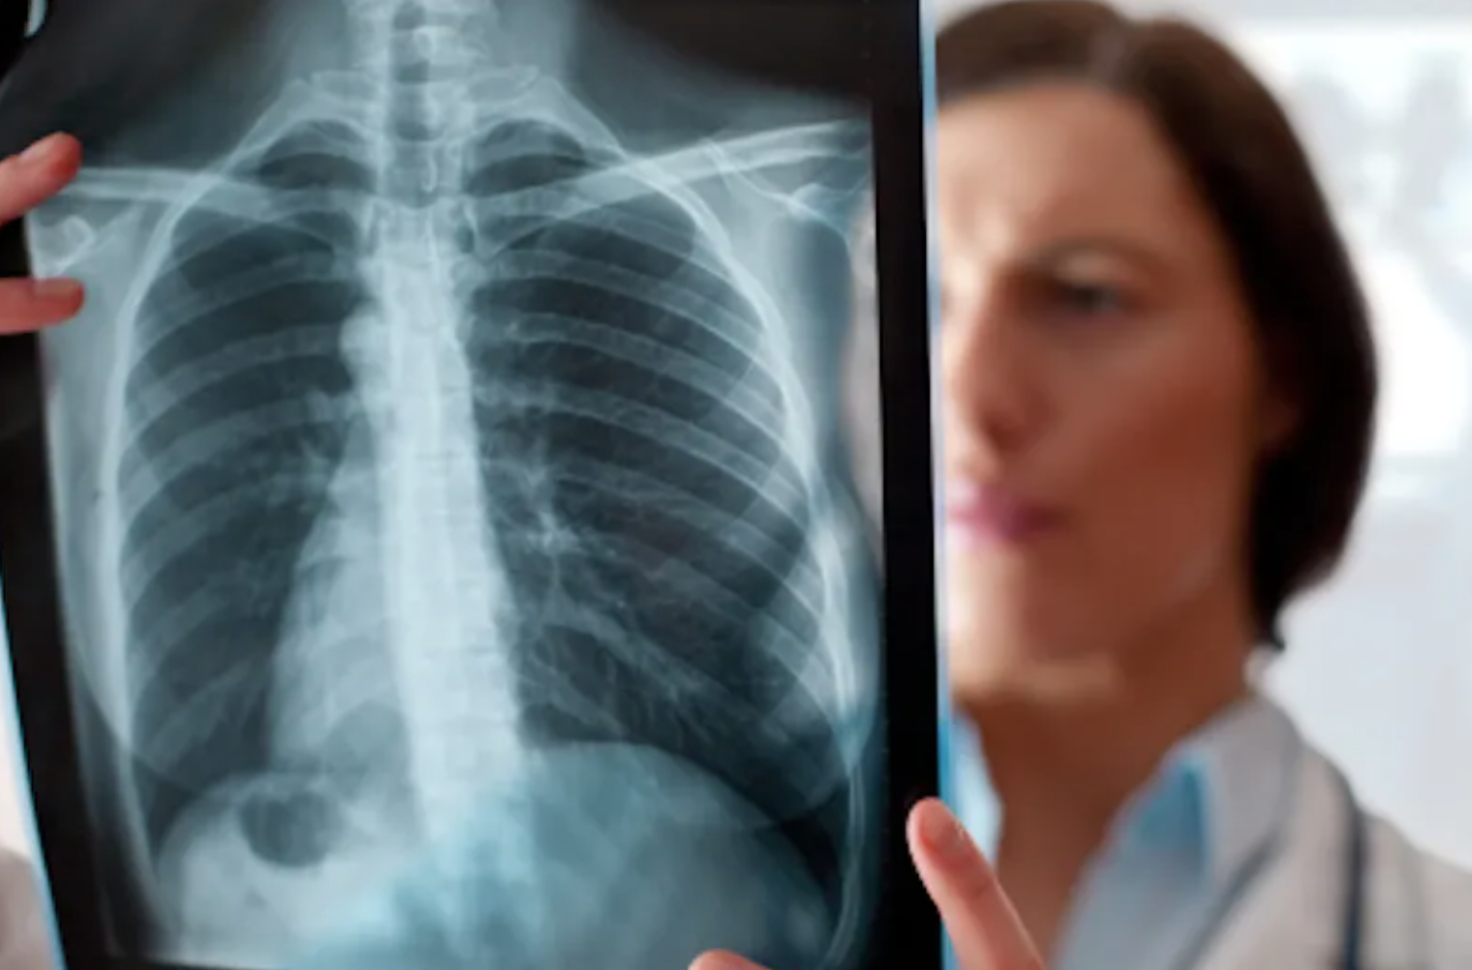
Diagnosing
Diagnosed in variety of ways
Commonly with chest X-ray
Find infection & severity of spread
Look for white spots in lungs
Interpreted by radiologist
Notes:
Pneumonia is diagnosed in a variety of ways.
(Blood test, pulse oximetry, sputum test)
One common way is through the use of a chest X-ray to find the infection and the severity of it's spread.
When interpreting the results, radiologists look for white spots in the lungs (called infiltrates) to identify the infection. Interpreting the results of chest X-rays requires careful observation and a good understanding of chest anatomy.

Slide 4
The Problem:
Increase in chest X-ray volumes
Significant backlogs
Average wait time: 30 days
How can HUP’s Lung Center implement a system to correctly classify chest X-rays as either pneumonia detected or normal with at least an 80% precision score by the end of 2021?
Notes:
Due to the increase in chest X-ray volumes, a significant backlog has formed
(COVID, larger patient volumes)
The average wait time is about 30 days for chest X-ray results
Causing delay in patient care
For these reasons, HUP’s lung center has asked a system be developed to correctly classify chest X-rays of suspected pneumonia patients as either normal or pneumonia detected
This will help radiologists reduce the backlog and give them more time to focus on abnormal results
They asked this first model have at least an 80% precision score and be ready for use by the end of 2021

Slide 5
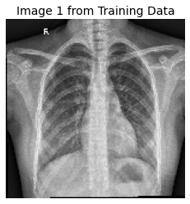
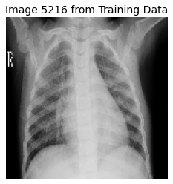
Data Information
Guangzhou Women and Children’s Medical Center
5,863 X-ray images (anterior-posterior)
File format: JPEG
Pediatric patients (1 to 5 years old)
Pre-split into training, testing and validation folders
Prescreen for quality control
Graded by expert physicians
Notes:
Data is provided by the Guangzhou Women and Children’s Medical Center
The set includes roughly 6,000 anterior-posterior chest X-ray images
Formatted as JPEG images
Each image is a different pediatric patient (1 to 5 years old)
The data is pre-split into train, test and validation folders
And prescreened for quality control (Low quality images removed)
All images are labelled and graded by at least two expert physicians

Slide 6
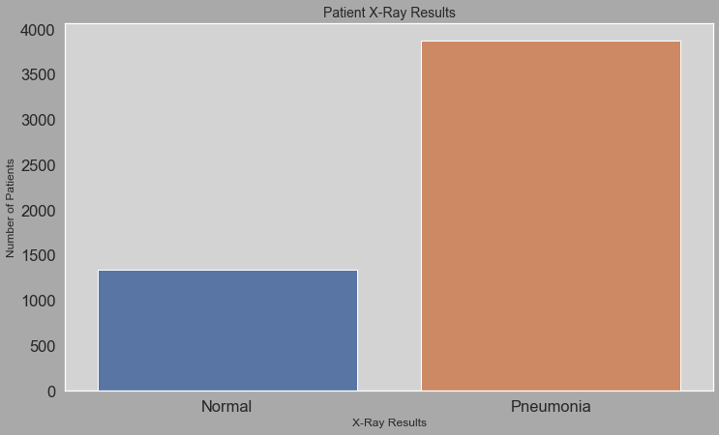
Labels
Binary categories
Class imbalance
Normal: 26%
Pneumonia: 74%
Notes:
Images within this dataset are labelled as either normal or pneumonia
As shown in this bar graph there is a class imbalance between label types
In the training set, normal images only account for about 26% of the total images

Slide 7
Model Overview
Supervised Learning: Images Labelled
Binary Classification: Pneumonia or Normal
Class Imbalance: More Pneumonia than Normal
Tools: Keras
Notes:
To solve this problem
Used supervised learning since data labelled
Used binary classification to classify images as either pneumonia or normal
There is a class imbalance in the data we have to correct for
And we used the keras library

Slide 8
Modeling Steps
Preprocess
Augment Data
Build Model
Fit Model
Evaluate
Shuffle
Equalize
Reshape
Weight classes
Normal: 1.94
Pneumonia: 0.67
Re-scale
Randomly
Rotate 25°
Zoom 20%
Shift width 10%
Shift height 10%
Flip horizontally
Four Convolutions
Traditional
Separable
Max Pooling
Batch Normalization
Flatten
Dropout 30%
Two Dense
Relu
Sigmoid
Optimizer: ADAM
Loss: binary cross entropy
Metrics: accuracy, F1, precision, recall
Epochs: 6
Validation data
Class weights
Learning rate reduction
Evaluate on test set
Notes:
Began by preprocessing the cleaned data set
Shuffled images to reorder (since data imported with all normal images followed by all pneumonia images)
Equalized the images to redistribute pixel values to optimize the full intensity range
Reshaped the image arrays so in proper shape for the model
Added weight classes to correct for the class imbalance
Normal: 1.94
Pneumonia: 0.67
Augment the data: to avoid overfitting the model due to the small size of the dataset
Allowed the data to re-scale the images
Randomly: rotate the images by a range of 25 degrees,
Zoom by a range of 20%
Shift width and height by a range of 10%
And horizontally flip the images
Built the model
Used four convolution layers
Two with 32 filters and two with 64 filters. For each number of filters, one convolution layer was traditional 2D and the other was separable 2D.
Used max pooling to save computational space between each convolution layer
As well as batch normalization
Added a Flattened layer
And a dropout layer to drop 30% of the nodes
Two dense layers
One relu with 128 unites
And one sigmoid with 1 unit
Fit model
Optimized using ADAM
Measured loss with binary cross entropy
Gathered accuracy, F1, precision, and recall metrics
Used 6 epochs
Used the validation data generated via data augmentation
Added class weights
And a learning rate reduction
Lastly evaluated the model on the test set

Slide 9
Model Performance
Training Data
Loss: 0.15
Accuary: 0.94
F1: 0.96
Precision: 0.98
Recall: 0.94
Validation Data
Loss: 1.07
Accuary: 0.63
F1: 0.72
Precision: 0.57
Recall: 1.00
Testing Data
Loss: 0.25
Accuary: 0.92
F1: 0.93
Precision: 0.91
Recall: 0.95
Model is overfit
Notes:
Looking at model performance the training data did exceptionally well
The validation data performed significantly worse
And the testing data performed very well but not as well as the training data
This tells us the model is overfit

Slide 10
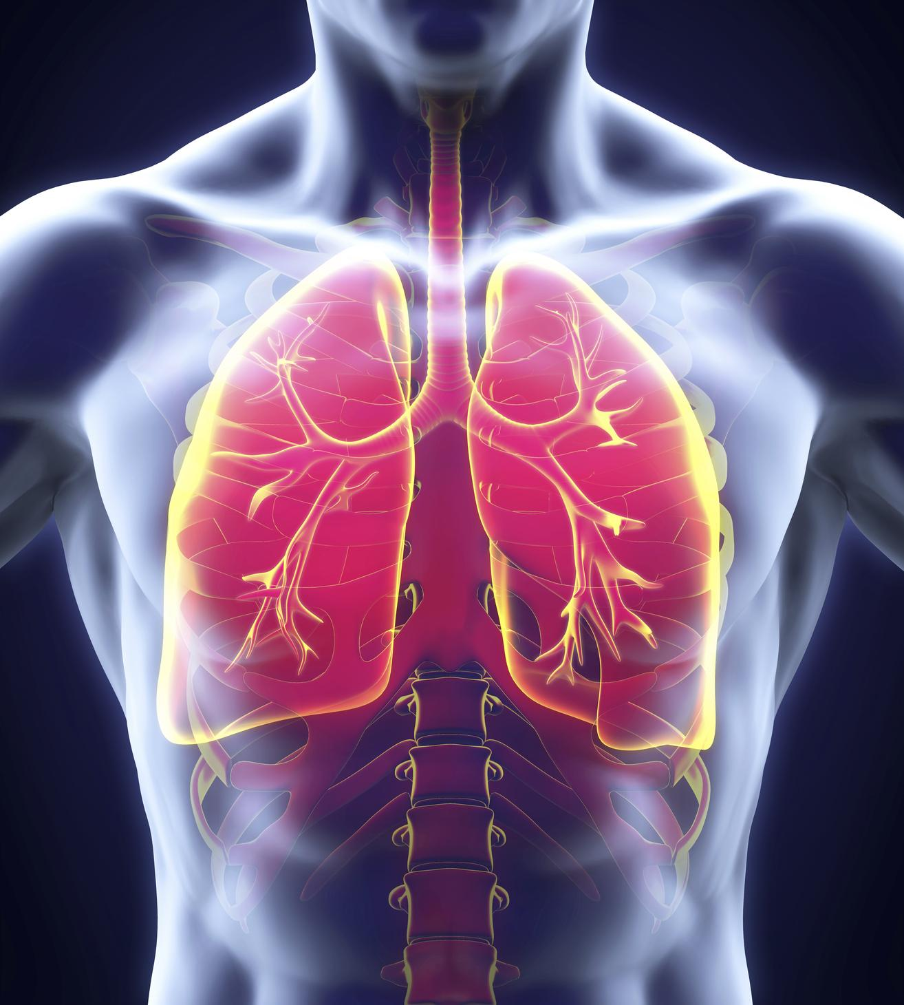
Constraints
Small dataset for image processing
Pre-split data
Small number of images for validation
Not labelled for severity of infection
Not labelled by cause of infection
Only looking at pediatric patients
Notes:
Some constraints
The dataset was fairly small for image processing
The data was pre-split
Only 0.3% of images were included in the validation set
Perhaps this is why the validation data performed so poorly
The images were also not labeled for severity of infection
Or by infection cause (bacterial, viral, fungal)
Lastly, only looking at pediatric patients

Slide 11
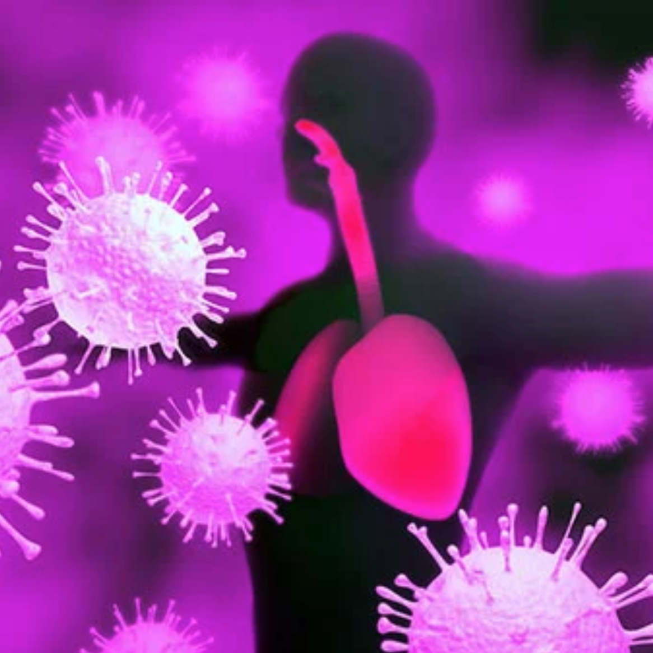
Ideas to Improve Model Performance
Optimize modeling layers
Gather adult patient data
Relabel images
Severity
Type of infection
Change split ratio
Notes:
To improve model performance
We can first optimize modeling layers.
Spending more time reworking these layers might result in higher performance
Can also gather adult patient data. Perhaps pediatric pneumonia manifests differently than in adult patients
Can relabel images for severity and type of infection
Might help model especially with less severe cases
Can change the split ration between train, test, and validation
Adding more samples to the validation set might help increase it’s performance

Slide 12
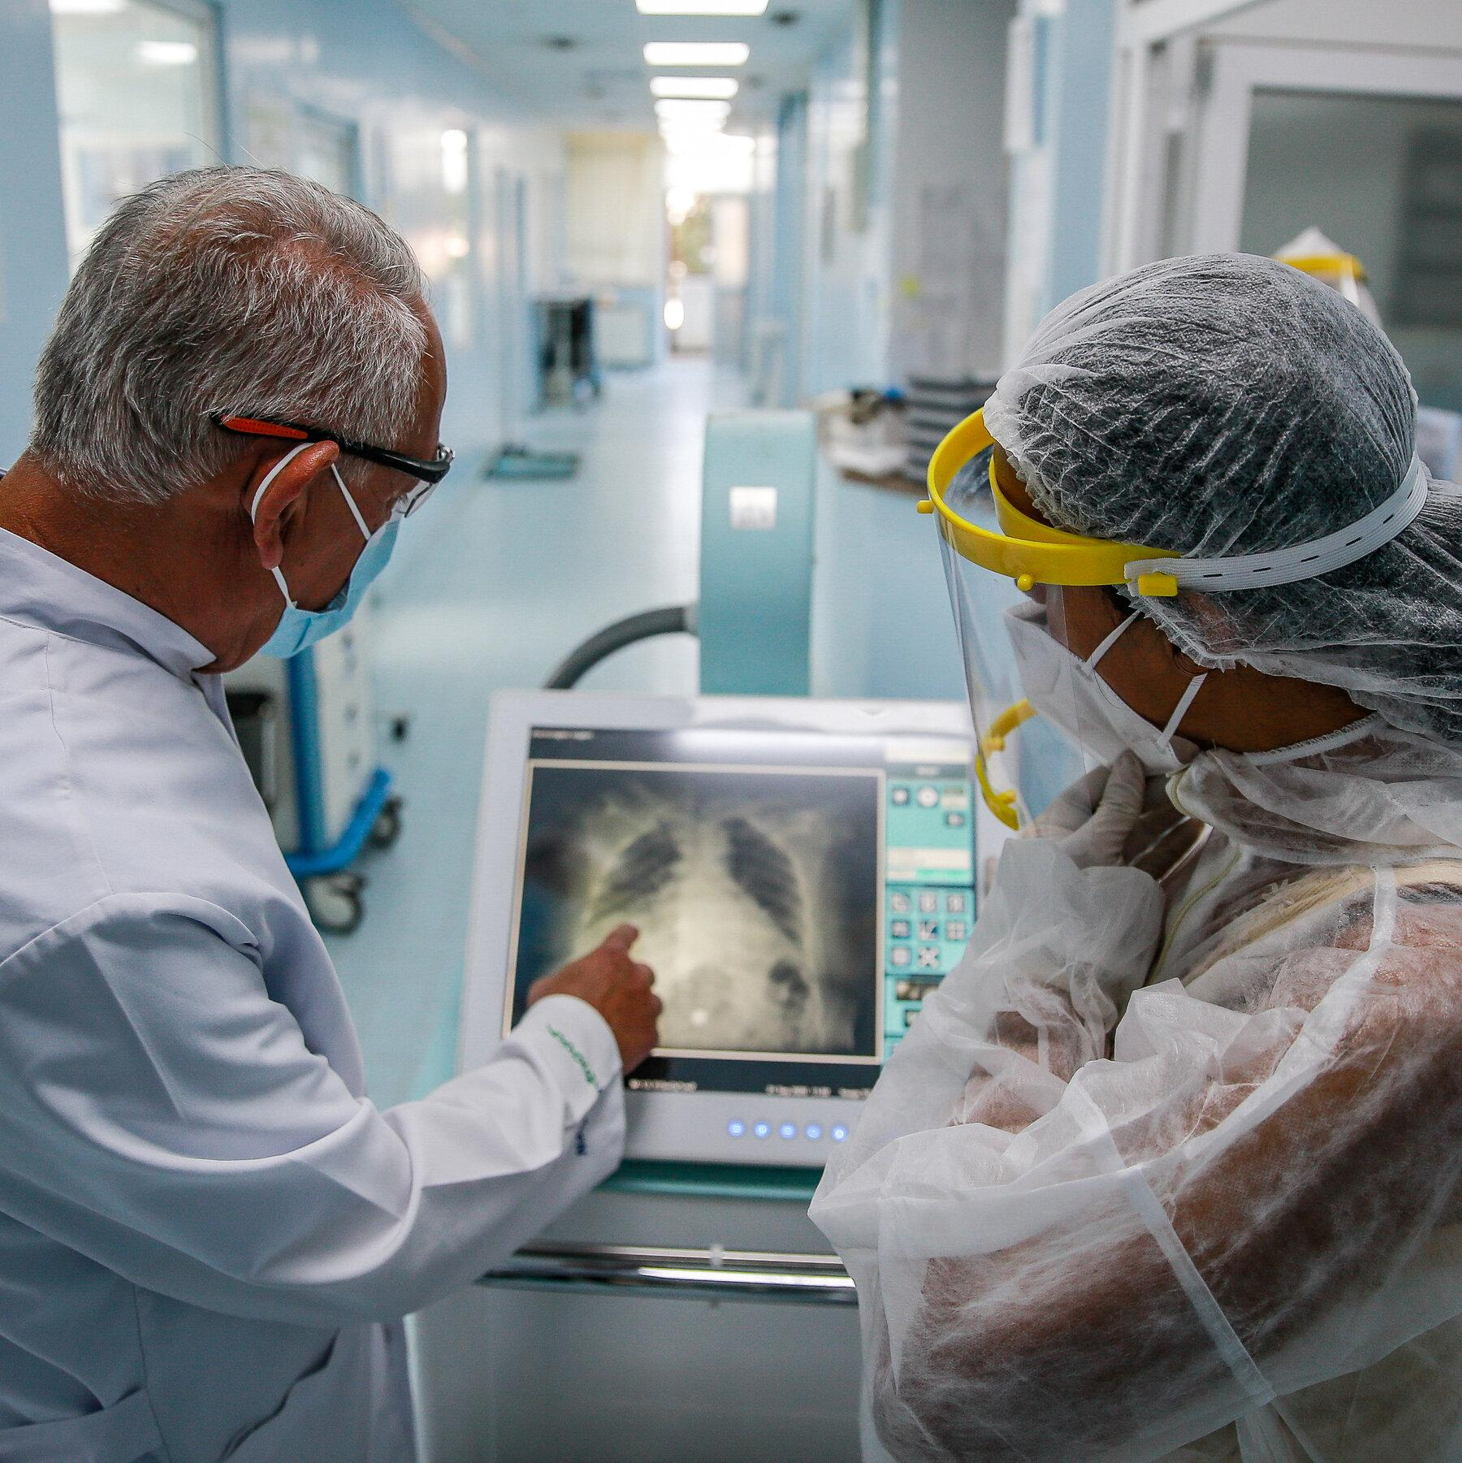
Further Research
Detect infection severity
Classify more illnesses
Research areas of infections
Notes:
This model can be used for a variety of future studies.
To begin, the model can be expanded to not only detect pneumonia but also classify the severity of the infection or even the cause of the infection (viral, bacterial, fungal).
Another use could be to expand the model to classify multiple types of chest X-ray diseases.
If all chest X-rays were first passed through an image processing model, radiologists could spend more time focusing on irregular X-rays and patients could receive results within days.
A third future use of this model could be to add image segmentation to research which areas of infection result in the most severe cases.
Are focal infections more likely to be severe than diffused ones?

Slide 13
Summary
Model: Keras convolution neural network
Model overfit
Test precision: 0.91
Val precision: 0.57
Constraints
Small dataset
Small validation set
Data not labelled for severity
Only pediatric X-rays
Improvements
Rework layers
Gather adult data
Relabel for severity
Relabel for cause of infection
Resplit data
Further research
Disease severity
Detect different disease types
Link infection area to disease severity
Notes:
The model was created using a Keras convolutional neural network.
The final model found a test precision of 91% and validation precision of 57%. This hints the model might be overfit.
Constraints include: the small dataset as a whole, the small number of images in the validation set, the data not being labelled for severity of infection, and only including pediatric X-rays.
Can improve the model by reworking the model layers, gathering adult data, relabelling data for severity and cause of infection, and resplitting the data
Ideas further research include classifying disease severity, detecting different types of diseases, and linking infection area to disease severity

